Slide 1
ONLINE EXAMINATION SYSTEM
Submitted to: Govind upadhyay
by
Devanshi Tyagi- 029
Ankit Mishra- 015

Slide 2
OUTLINE
Introduction
SDLC (Software development life cycle)
Prototype model
Block diagram of the system
Use case diagram
ER diagram
DFD
Project Slides

Slide 3
INTRODUCTION
During this time of pandemic situation where students are unable to attend their exams, Online Examination System comes into play. As it is difficult for colleges to conduct exams Online Examination system makes it easier. Teacher can upload questions for exam purposes according to their subjects. This System allows the students to not only appear in the exams but also to take 30 minutes’ quizzes to practice for their exams. Results will be generated at the end of the exam. Students don’t have to wait to get their result. As soon as the exam is over the next screen will be the result screen. Students will find blogs at the end of the website which will help them to boost themselves for studies. Tips for better marks, self-confidence build up techniques, and interesting facts are all part of the blog. Anyone can ask any question through the feedback.

Slide 4
Software Development Life Cycle(SDLC)
Software Development Life Cycle (SDLC) is a process used by the software industry to design, develop and test high quality softwares. ... It is also called as Software Development Process. SDLC is a framework defining tasks performed at each step in the software development process.
Model used in making of this system:
PROTOTYPE MODEL

Slide 5
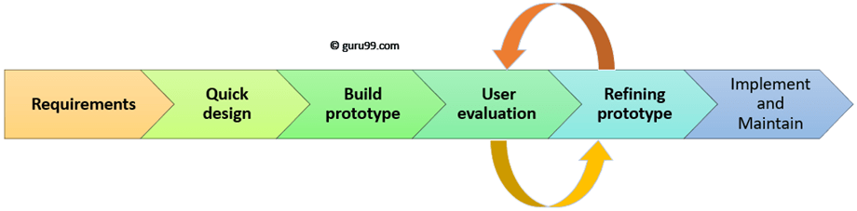
PROTOTYPE MODEL
Prototyping Model is a software development model in which prototype is built, tested, and reworked until an acceptable prototype is achieved. It also creates base to produce the final system or software. It works best in scenarios where the project's requirements are not known in detail. It is an iterative, trial and error method which takes place between developer and client.

Slide 6
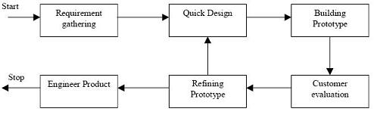
Working of Prototype model

Slide 7
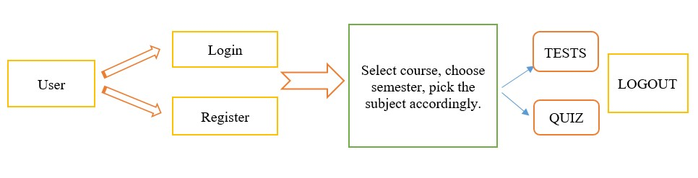
Block Diagram of the System

Slide 8
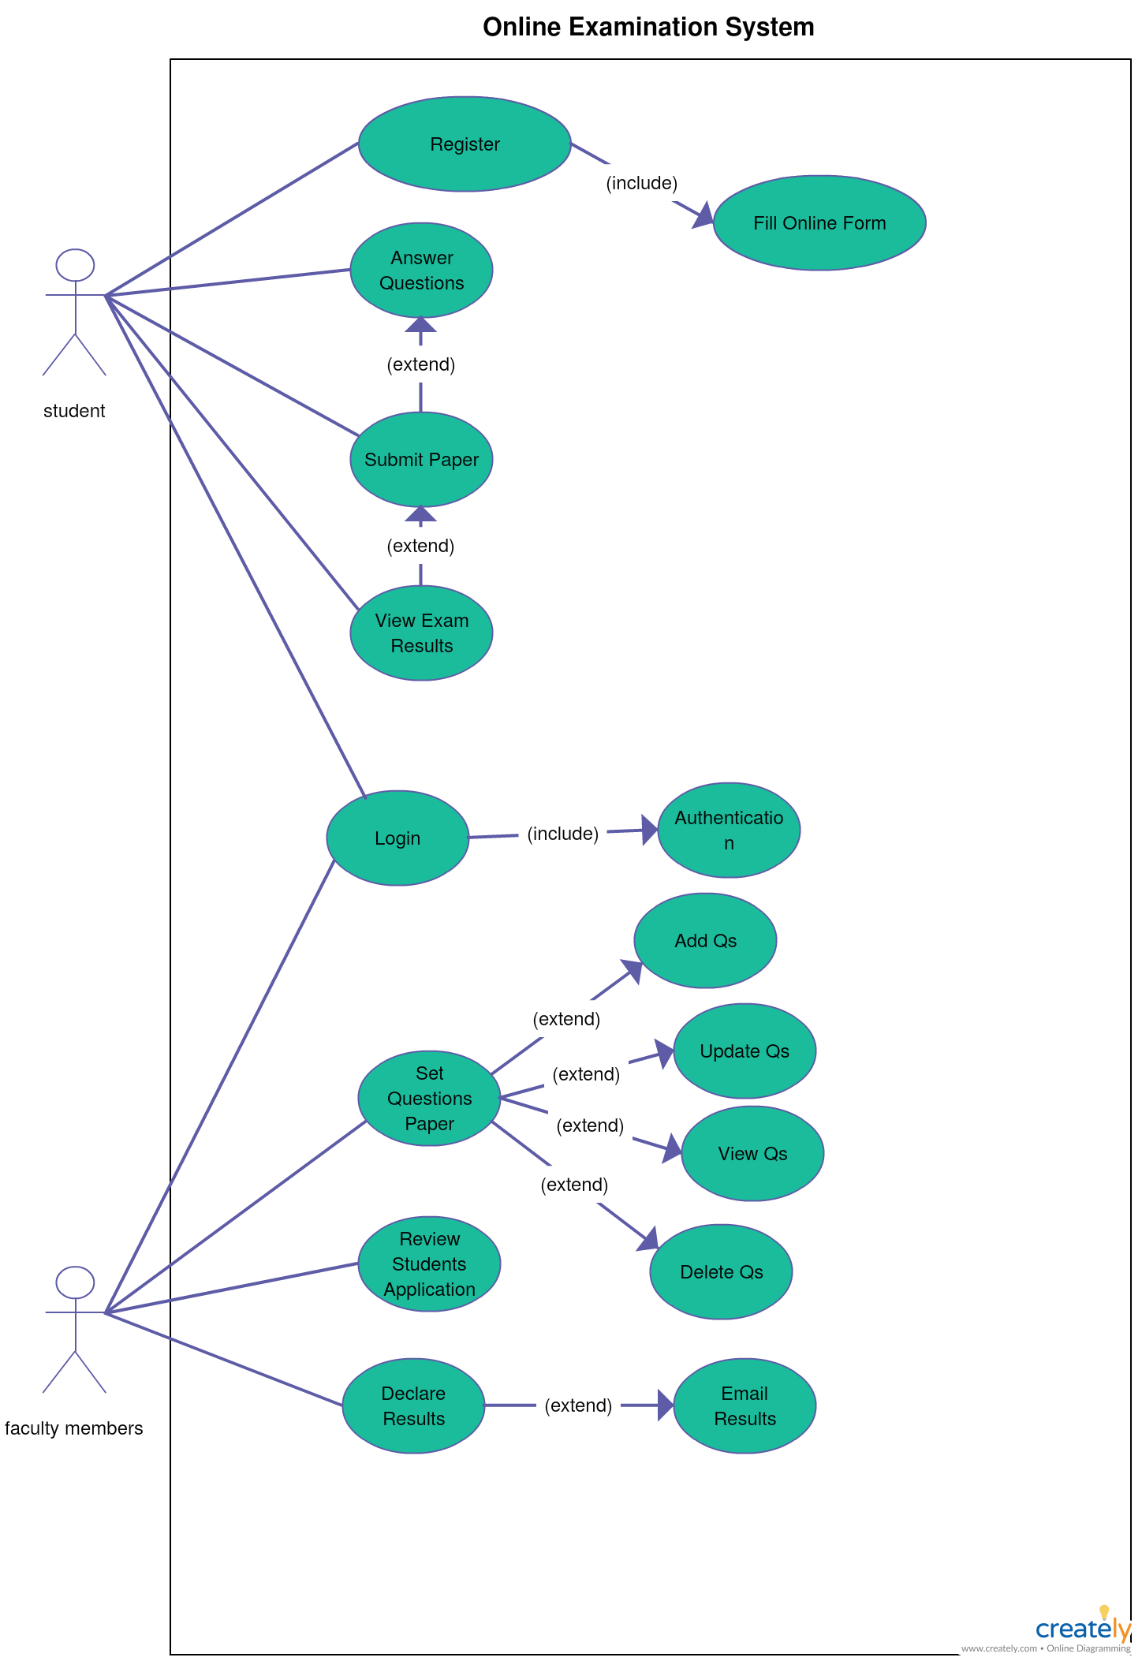
USE-CASE

Slide 9
ENTITY RELATIONSHIP DIAGRAM
An Entity–relationship model (ER model) describes the structure of a database with the help of a diagram, which is known as Entity Relationship Diagram (ER Diagram). An ER model is a design or blueprint of a database that can later be implemented as a database. The main components of E-R model are: entity set and relationship set.

Slide 10
Username
Password
Receive
Register
LOGIN
FirstName
Marks
LastName
DOB
EXAM RESULT
Registration
DOB
Result
Gender
Result
EXAMINATION
Perform
Email-id
C
Subject
Password
OS
BCA
BTech
BCom
BBA
C++

Slide 11
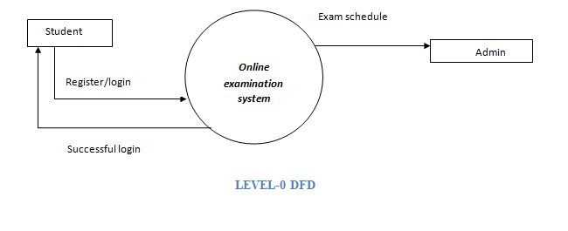
DFD 0 -level

Slide 12
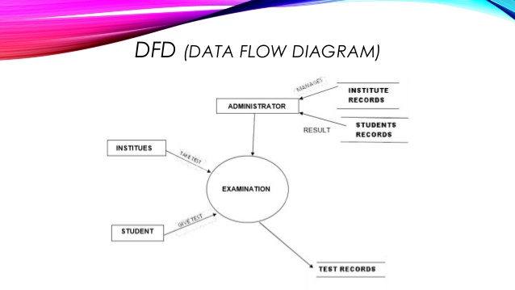
DFD

Slide 13
PROJECT SLIDES

Slide 14
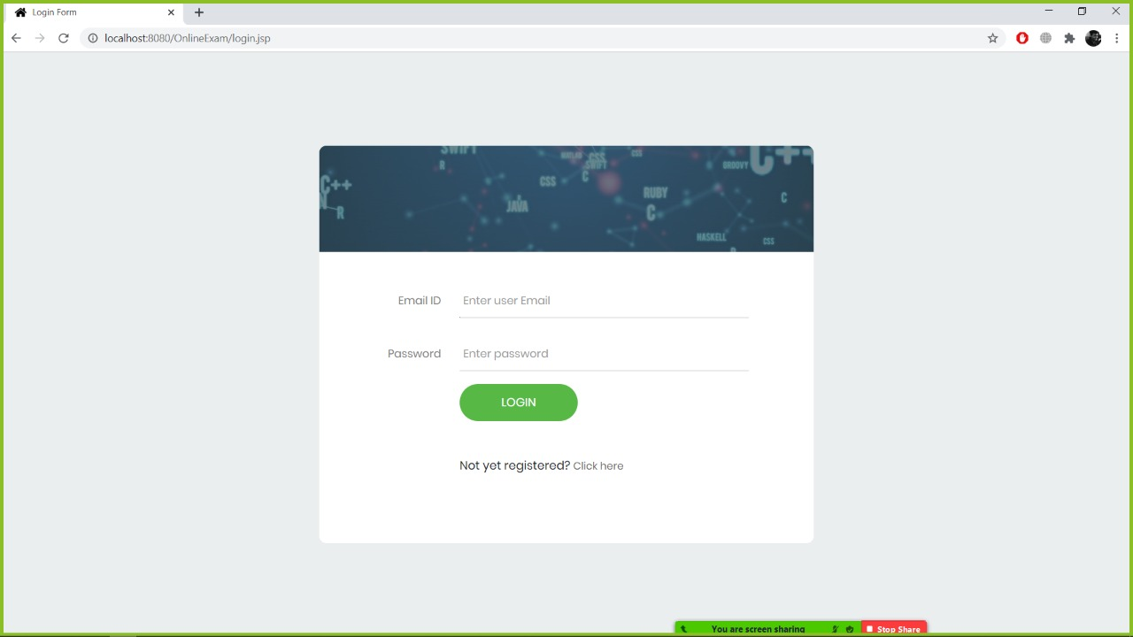
Login Screen

Slide 15
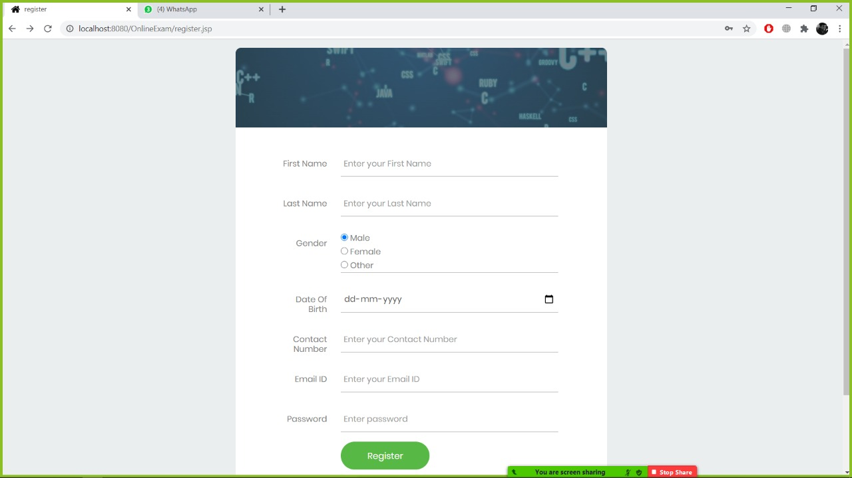
Registration Screen

Slide 16

MAIN SCREEN :

Slide 17
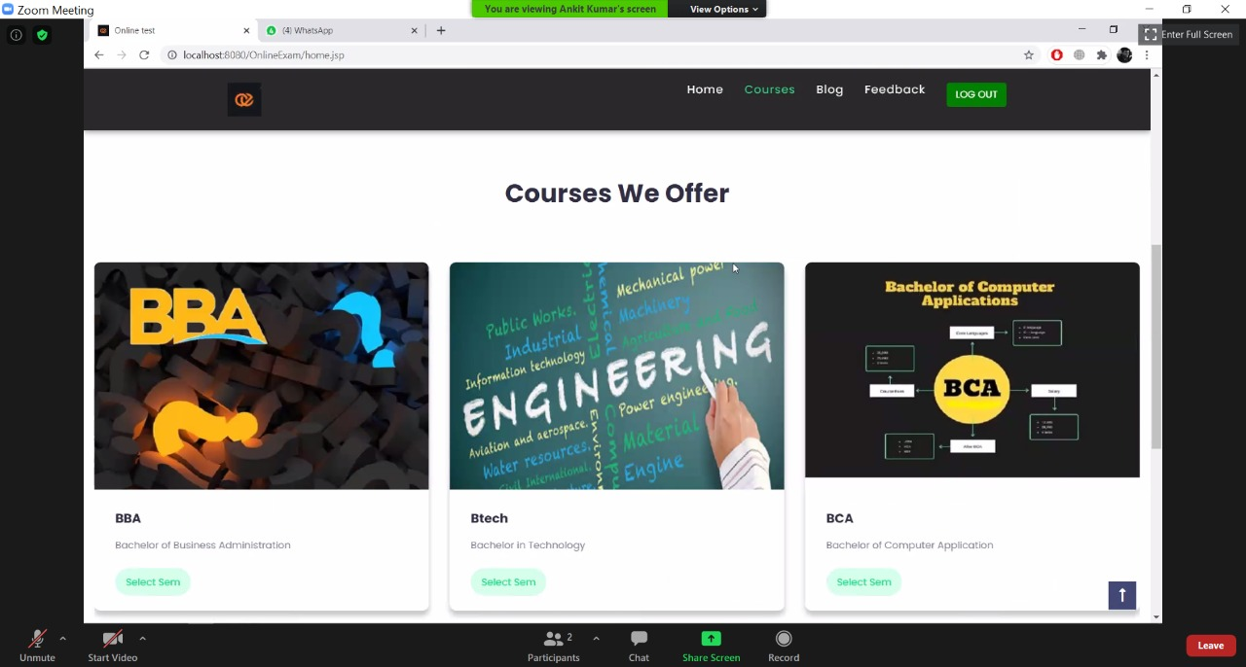
Courses

Slide 18
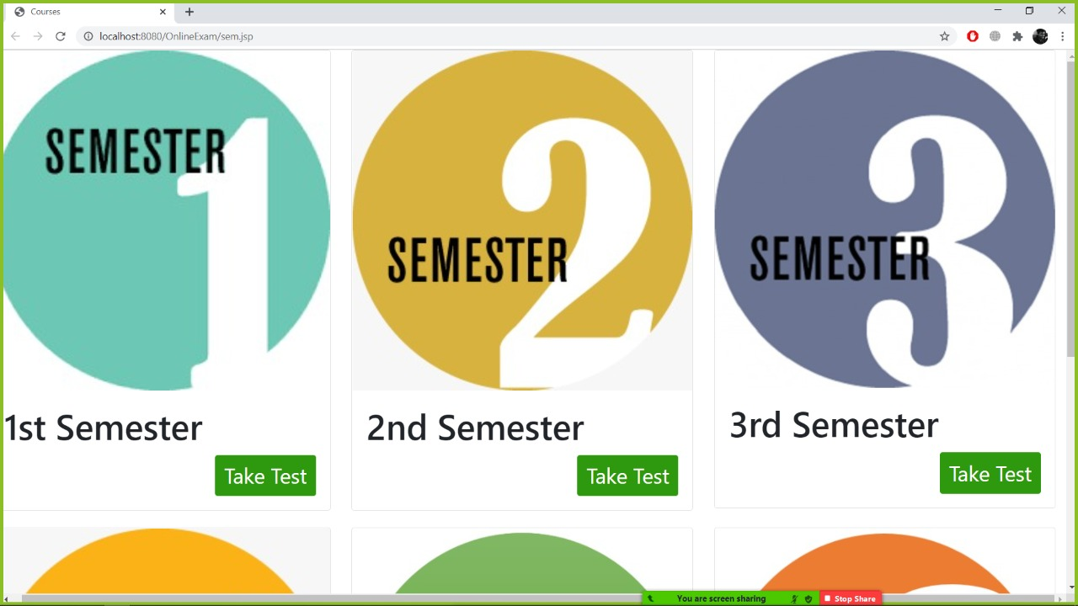
Semester

Slide 19
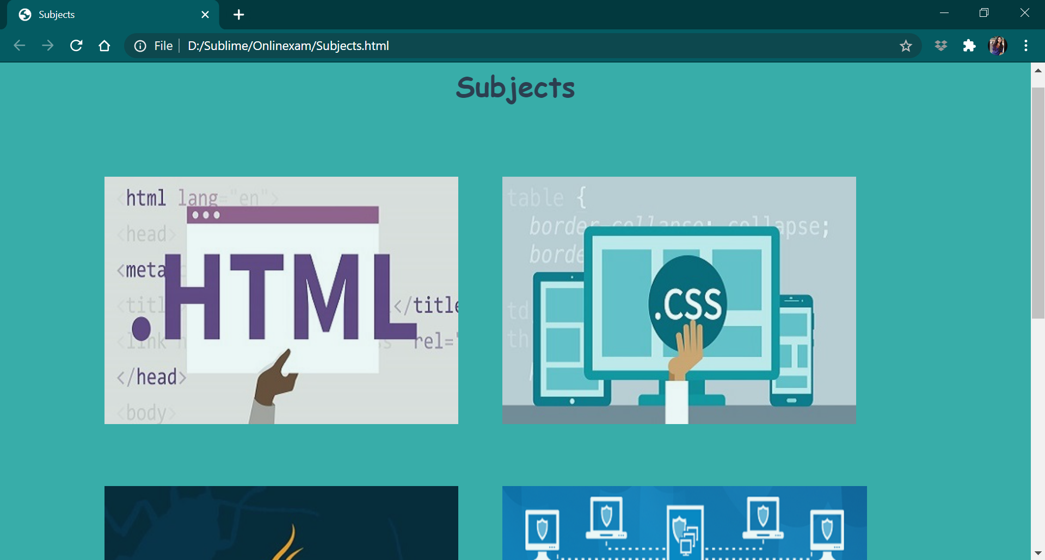
Subjects

Slide 20
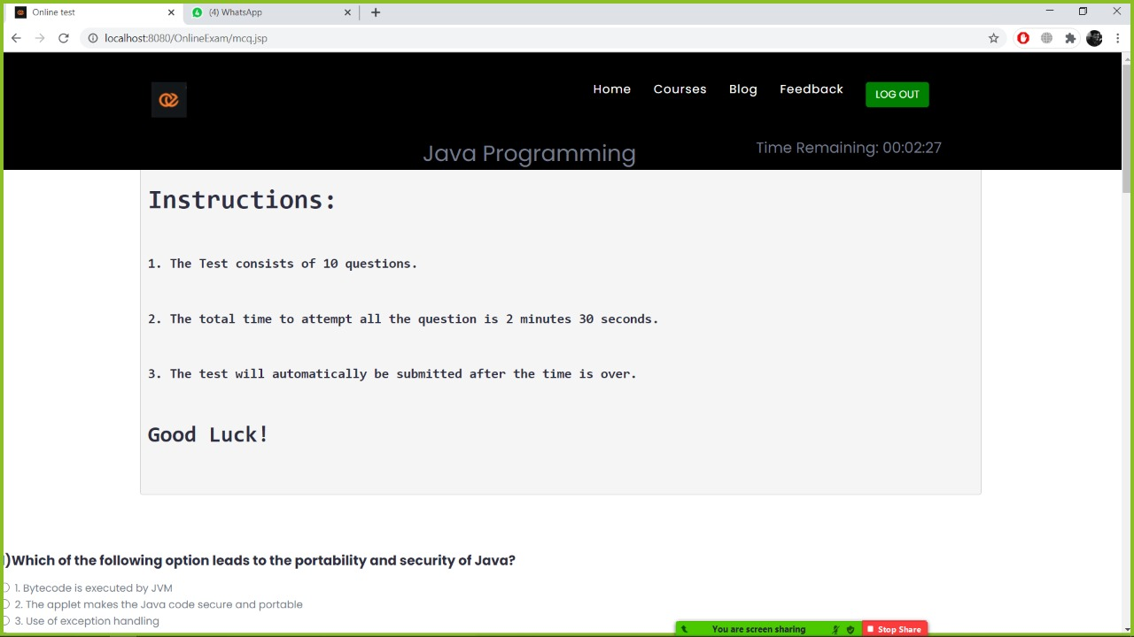
Test Screen

Slide 21
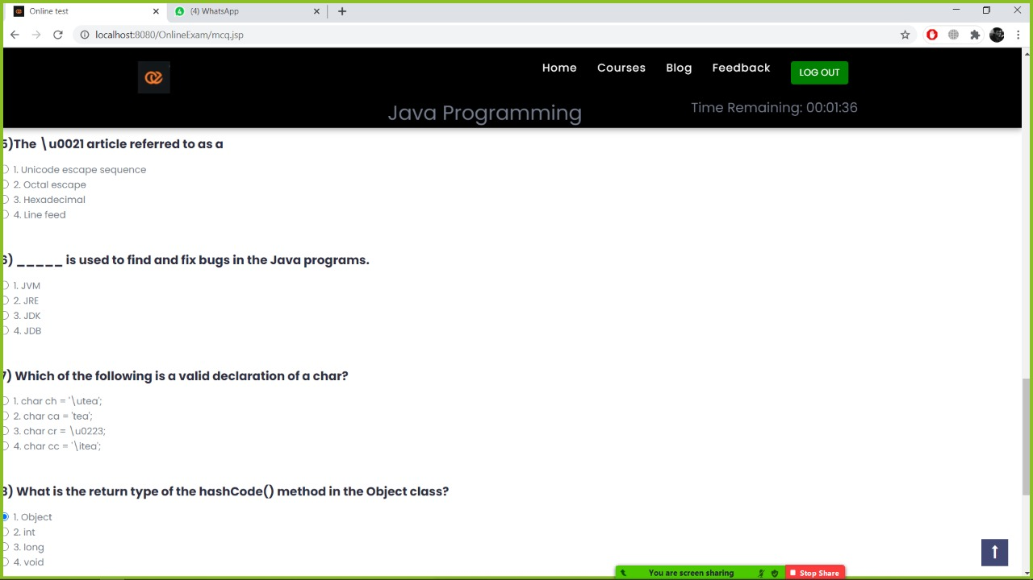
Above-stated snapshot is the exam screen where students will be given a required amount of time so as to complete the exam. Questions are based on the subject selected. After the students are over and done with their test, their result on the basis of attempted , correct and wrong will be shown to them just like in the next slide.

Slide 22
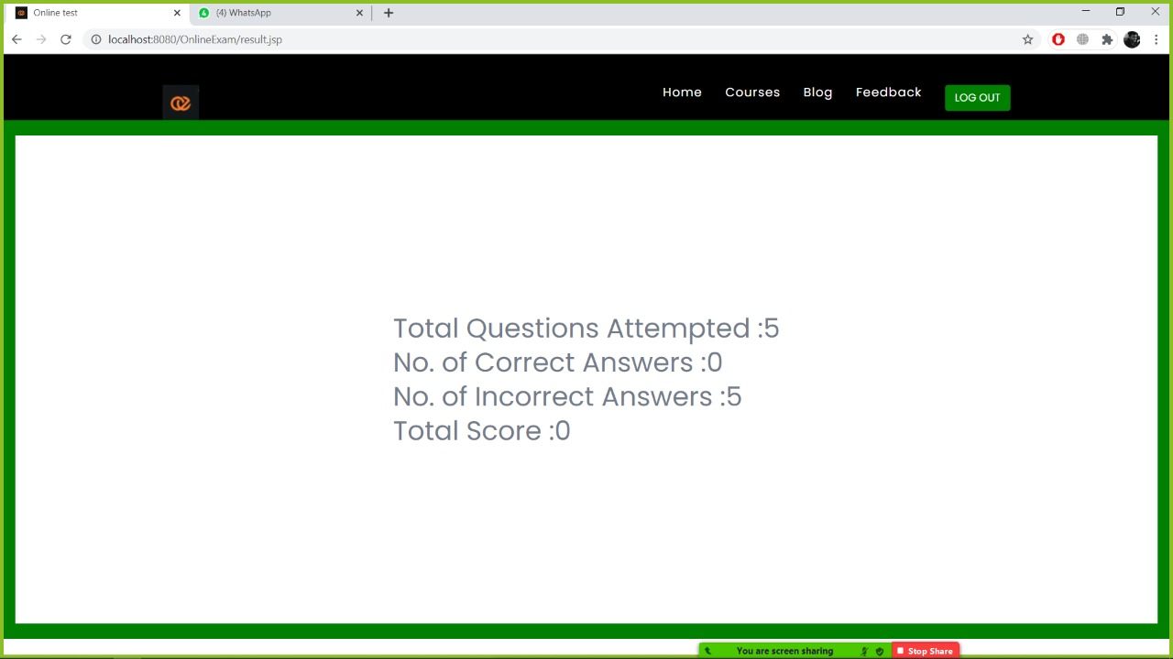
After Completion Of The Exam

Slide 23
Database tables

Slide 24
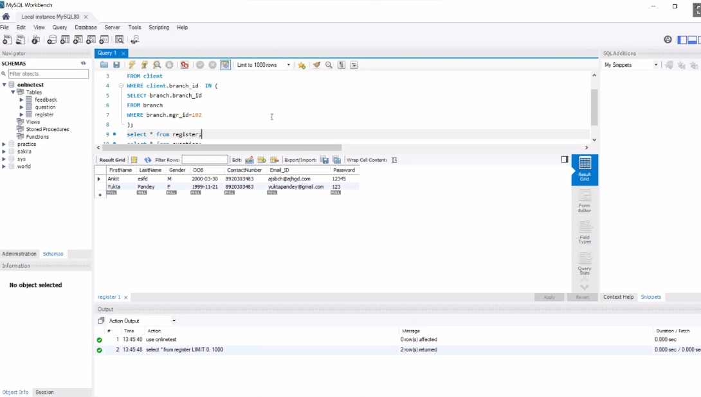
Login Table

Slide 25
Registration Table

Slide 26
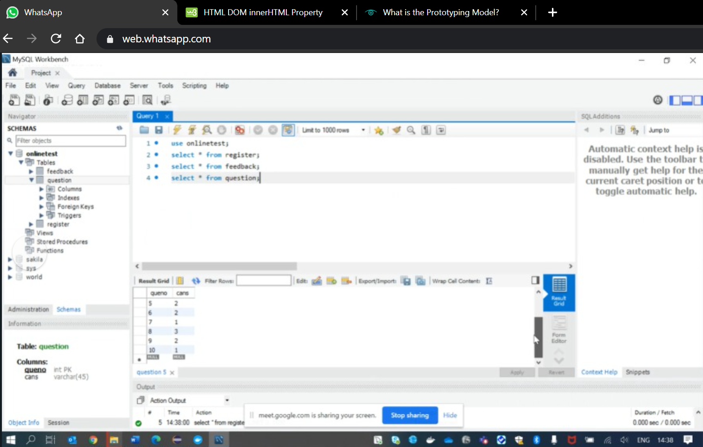
Question-Answer table

Slide 27
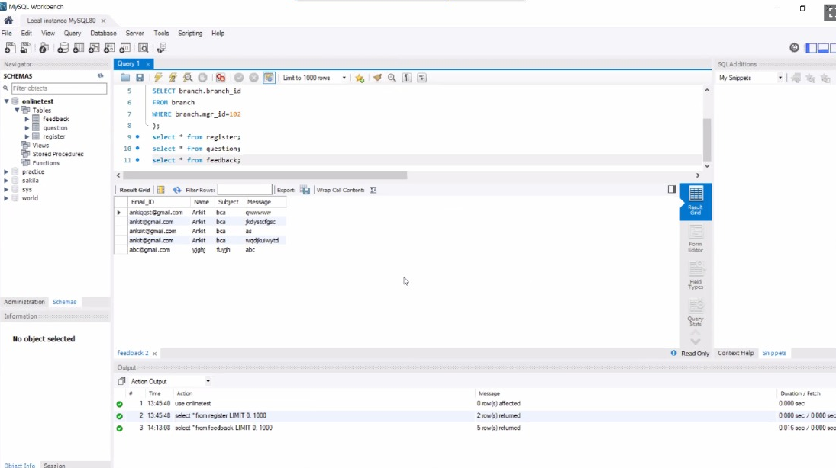
Feedback table

Slide 28
Thankyou!

